Slide 1



30th Tennessee Airports Conference

Slide 2
Agenda:
Global Aerospace’s Airport Safety Advocacy Program
Case Studies
Developing Minimum Standards
Q&A

Slide 3
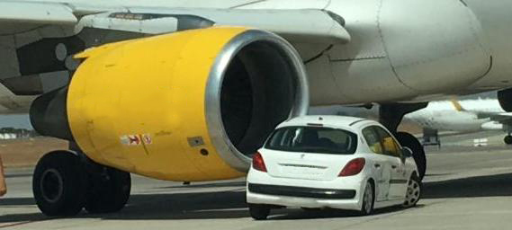
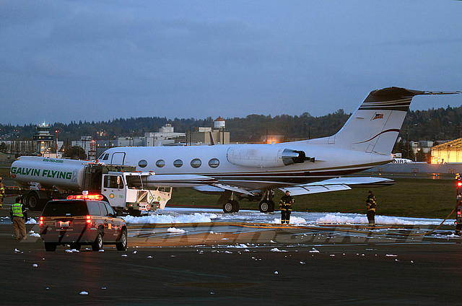
No one is exempt!

Slide 4


Slide 5


Slide 7
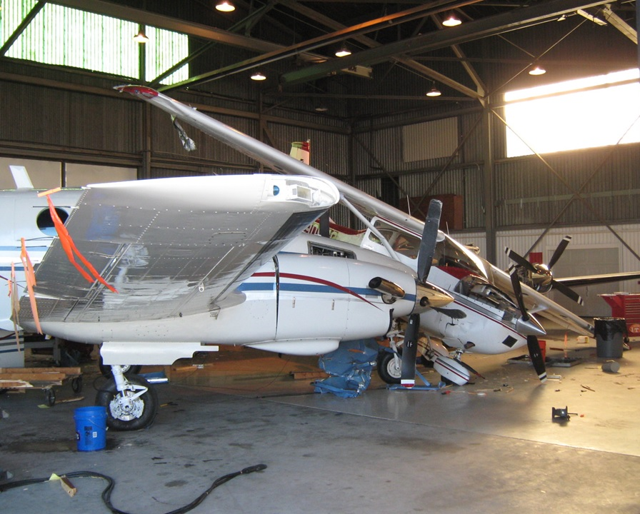

Slide 8
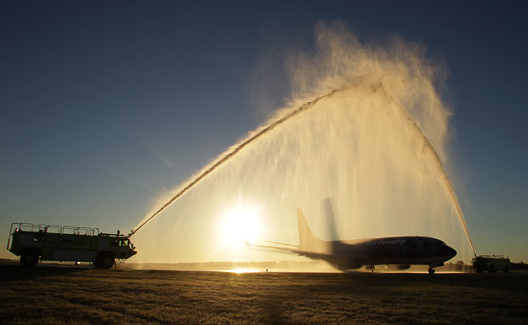

Slide 10
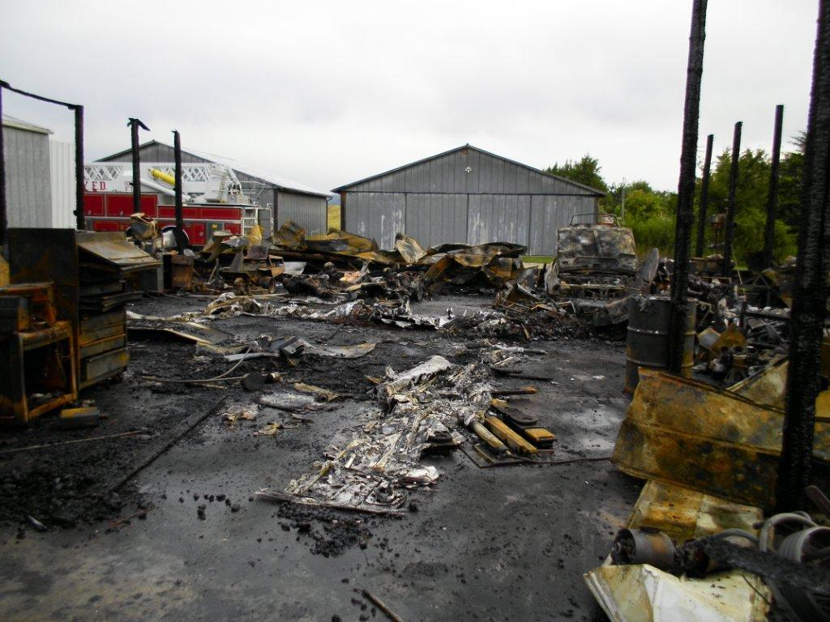

Slide 11
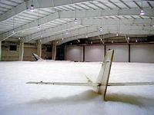

Slide 12


Slide 13
Emergency Response Day
Airfield Safety Manuals
Press Briefing

Slide 14
Questions?

Slide 15
Thank you!

