Slide 1
Briefing for Tennessee Airports Association

Slide 2
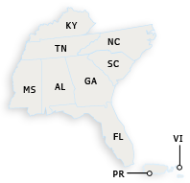
Southern Region and
Southern Regional Office
Atlanta, GA
Outreach to GA, FL, AL, MS, NC, SC, TN, KY, PR and VI

Slide 3
FAA Organizational Structure

Slide 4
National Airspace System
Risk-Based Decision Making
Making aviation safer and smarter
Delivering benefits through technology and infrastructure
Workforce of the Future
Global Leadership
Shaping global standards and enhancing harmonization
Empowering and innovating with the FAA’s people

Slide 5
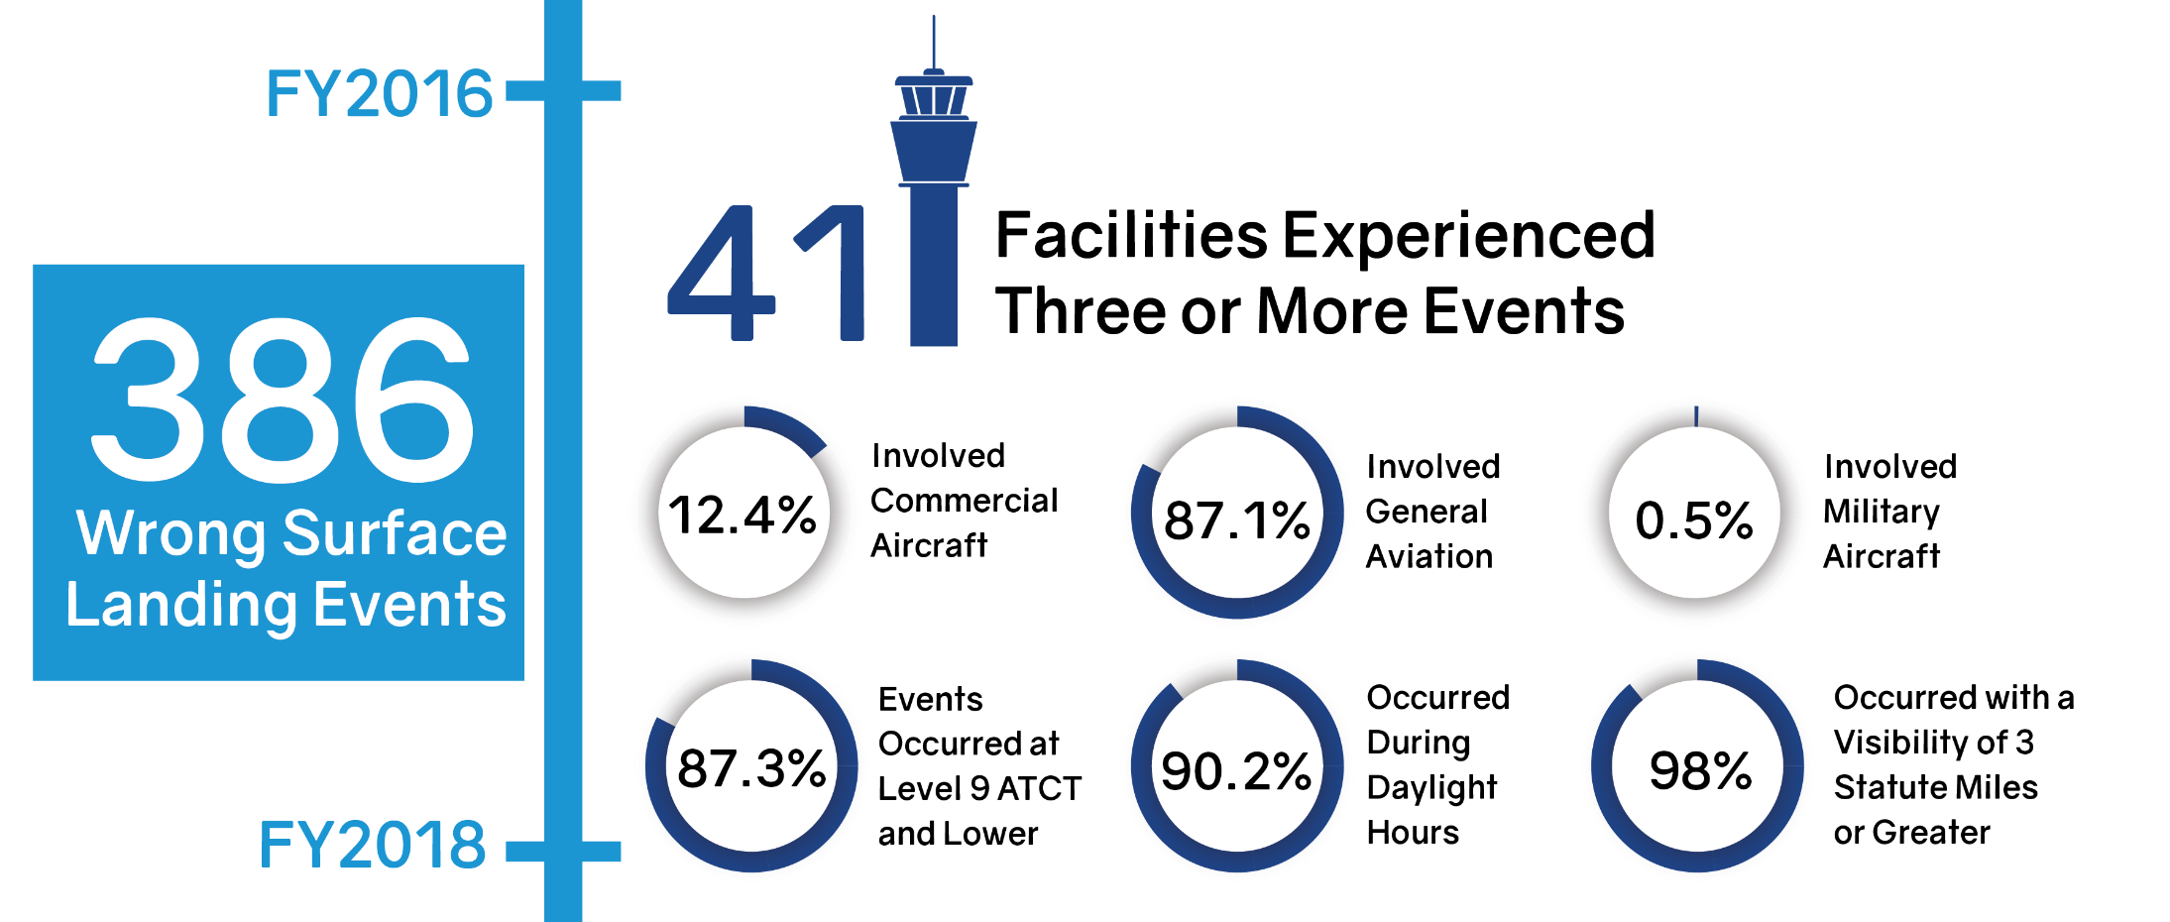
Wrong Surface Landings and Approaches
Source: Runway Safety Team

Slide 6
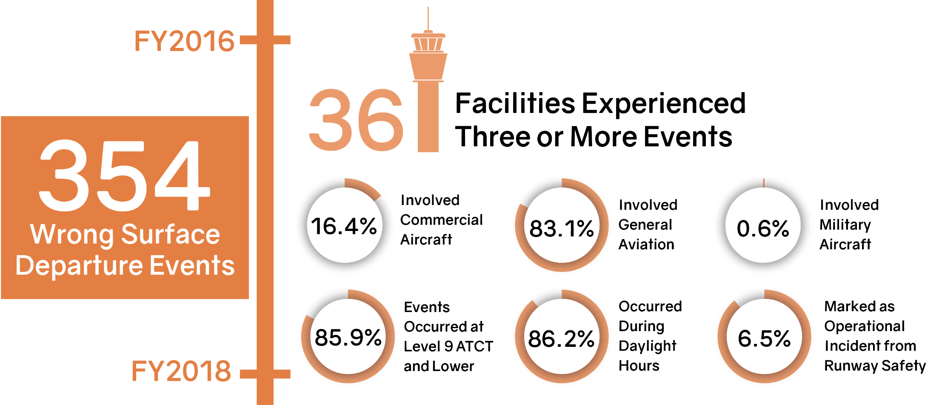
Wrong Surface Departures
Source: Runway Safety Team

Slide 7
TN RSAT Site Meetings
Facility | Previous | Next
Chattanooga (TN) | 07/25/2017
Jackson (MKL) | 07/18/2017
Knoxville (TYS) | 08/10/2017
Memphis (MEM) | 02/22/2018
Millington (NQA) | 05/19/2017
Nashville (BNA) | 08/28/2017
Smyrna (MQY) | 01/18/2018
Tri-Cities (TRI) | 02/22/2017 | TBD
Source: Runway Safety Team

Slide 8

FAA Authorization / Appropriation
Authorization
Public Law 115-141 (Division M, Title I – Airport and Airways Extension Act of 2018) extends our authorization from March 31, 2018 to September 30, 2018.
Appropriation
Public Law 115-141 (Consolidated Appropriations Act, 2018) extends our appropriations from March 23, 2018 to September 30, 2018.

Slide 9
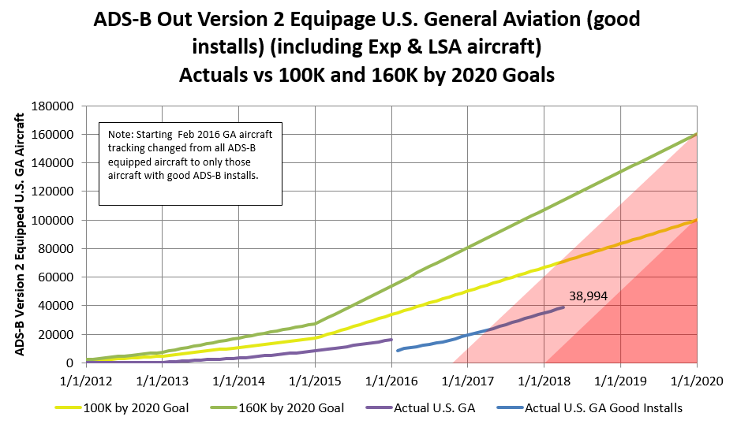
ADS-B Equipage Numbers
Source: Flight Standards ADS-B Focus Team – April 2018

Slide 11

By January 1, 2020, you must be equipped with ADS-B Out to fly in most controlled airspace.

Slide 12
UAS Integration Pilot Program (IPP)
IPP is an opportunity for:
State, local, and tribal governments to partner with private sector entities, such as UAS operators or manufacturers, to accelerate safe UAS integration
Expected outcomes:
New and expanded commercial UAS operations
Meaningful dialogue on the balance between local,
state and national interests related to UAS integration
Actionable information to the DOT on expanded and
universal integration of UAS into the NAS
Source: FAA Website

Slide 13
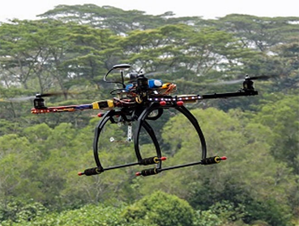
Emergency UAS Certificates of Authorization
“Essentially, every drone that flew meant that a traditional aircraft was not putting an additional strain on an already fragile system. I don’t think it’s an exaggeration to say that the hurricane response will be looked back upon as a landmark in the evolution of drone usage in this country,” Michael Huerta, former FAA Administrator
Hurricane Harvey—142 COAs
Hurricane Irma—198 COAs
Hurricane Maria – 10 COAs
Hurricane Nate – 5 COAs
Source: Significant Incident Management Operations, AJR-221

Slide 14
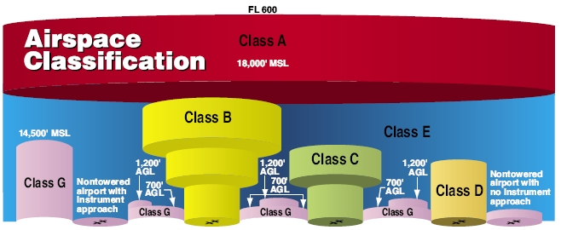
Part 107 Airspace Requirements
Operations in Class G without ATC authorization
Operations in Class B, C, D & Class E surface areas require ATC authorization
Phased approach to airspace authorizations
Online portal available at www.faa.gov/uas/request_waiver/

Slide 15
U.S. Launch Sites - Spaceports
Source: Office of Commercial Space Transportation

Slide 16
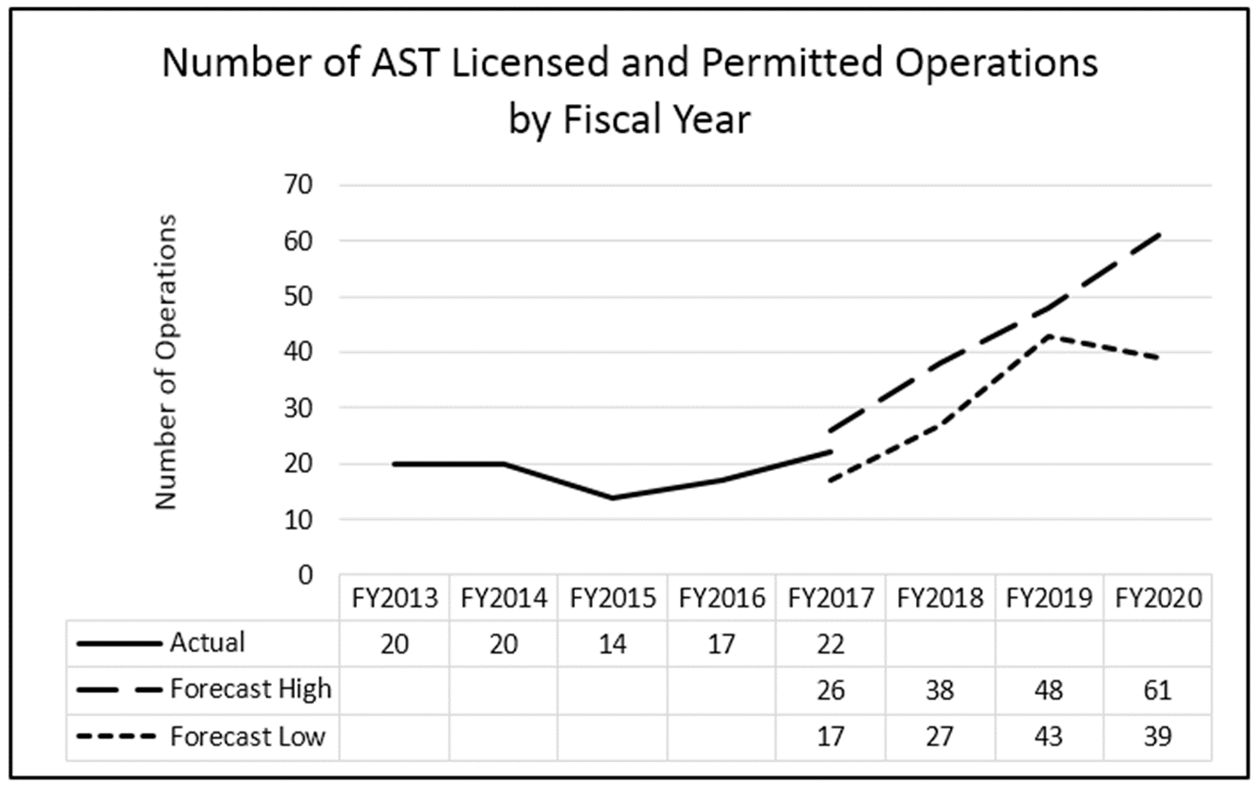
Long Term Commercial Space Forecast
Source: Office of Commercial Space Transportation

Slide 17
National Plan of Integrated Airport Systems

Slide 18
Tennessee Passenger Enplanements
 | CY2016 | CY2015 | % change
Nashville International (BNA) | 6,338,517 | 5,715,205 | 10.91%
Memphis International (MEM) | 2,016,089 | 1,873,716 | 7.60%
McGhee Tyson (TYS) | 887,103 | 848,390 | 4.56%
Chattanooga/Lovell Field (CHA) | 422,442 | 393,680 | 7.31%
Tri-Cities Regional (TRI) | 204,926 | 216,426 | -5.31%
Total Enplanements | 9,869,077 | 9,047,417 | 9.08%
Source: CY 2016 ACAIS report dated 10/5/17

Slide 19
Tennessee Airport Operations
 | 2017 | 2016 | 2015
Nashville International (BNA) | 204,731 | 190,432 | 182,365
Memphis International (MEM) | 222,271 | 224,541 | 219,617
McGhee Tyson (TYS) | 102,875 | 95,764 | 95,579
Chattanooga/Lovell Field (CHA) | 59,610 | 56,333 | 51,574
Tri-Cities (TRI) | 39,873 | 46,519 | 47,317
Smyrna Airport (MQY) | 72,167 | 66,968 | 65,489
Millington Regional Jetport (NQA) | 35,940 | 35,966 | 26,703
McKellar-Sipes Regional Airport (MKL) | 15,654 | 16,768 | 16,418
Total Operations | 753,121 | 733,291 | 705,062
Source: Air Traffic Activity System (ATADS) report by FY as of 03/19/2018

Slide 20
Tennessee Air Traffic Control Towers
FAA Towers
Nashville International (BNA)
Memphis International (MEM)
McGhee Tyson (TYS)
Chattanooga/Lovell Field
Tri-Cities Regional (TRI)
FCT – Federal Contract Towers
Smyrna Airport (MQY)
Millington Regional Jetport (NQA)
McKellar-Sipes Regional (MKL)
Source: ATO

Slide 21
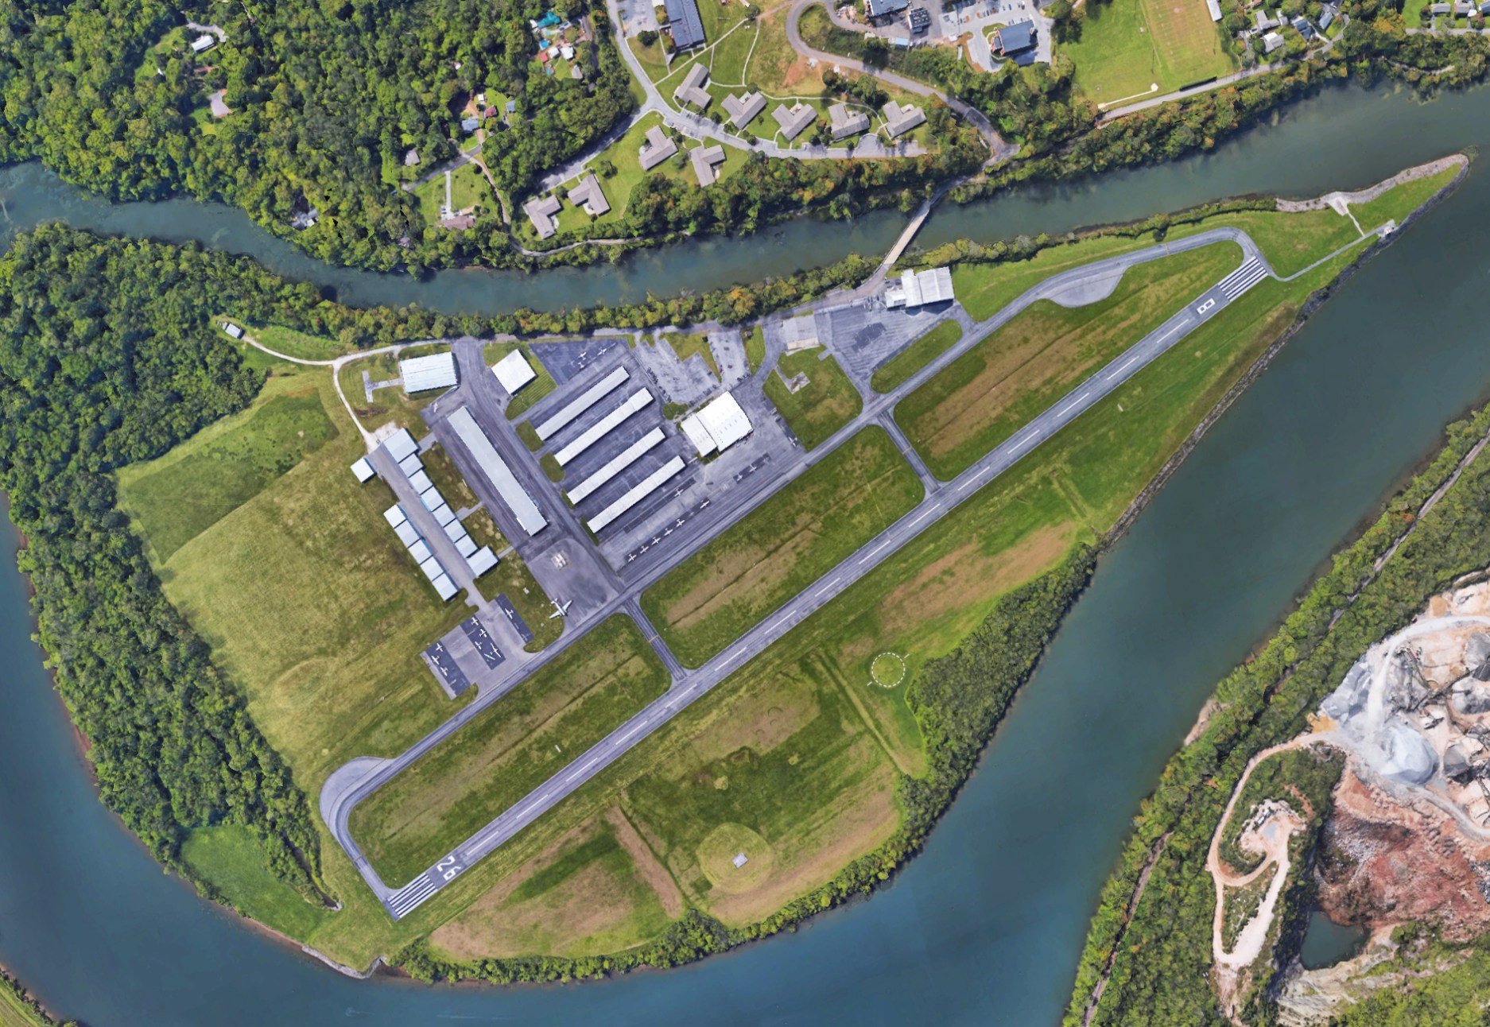
Which TN Airport is this?

Slide 22
Knoxville Downtown Island Airport
Source: dkxairport.com website

