Slide 1
FAA State Block Grant Program
Notes:
Chad said that he received a request for the FAA to provide an update on the State Block Grant program. I am sure many people have been hearing whispers on the program. It is always been an out of the ordinary way in which we manage the AIP Program. For most non-block grant states , the relationship is pretty straight forward. With block grant states, there are many TN GA airports I have never visited because for all intensive purposes, the Division of Aeronautics manages the AIP projects for all nonprimary airports. Let me give you a quick statistic, as of Friday the 13th, the amount of unexpended AIP funds for the SBGP was approximately $54million……That’s $54million.

Slide 2
FAA
Airport Sponsor
TDOT Aeronautics
Airport Consultant
AIP Program
Notes:
The objective of this presentation is to provide information on the state block grant program and what things have taken place in an effort to expend funds in a more timely manner.
Briefly walkthrough new guidance
Discuss some next steps in making this program a more successful one.

Slide 3
Objectives
Background
New Guidance
Next Steps
Notes:
There are currently 10 states in the FAA State Block Grant Program.
There is an expectation that there will be additional states to join the program.
It’s not yet clear, which states are more or less likely to seek admission.

Slide 4
Which States are In?
Created in 1996
Original 7 expanded to 10
Little implementing guidance
Notes:
There are currently 10 states in the FAA State Block Grant Program.
There is an expectation that there will be additional states to join the program.
It’s not yet clear, which states are more or less likely to seek admission.

Slide 5
What is a “Block Grant”?
Historically a lump sum of $ awarded to a State for their use as identified in a State Block Grant Memorandum of Agreement (MOA).
States distribute $ for capital development at non-primary airports.
Still subject to FAA program rules, guidelines, and policies. Limited MOA linked FAA with States.
Allows States to have flexibility for carrying out the grant program effectively and efficiently.
Operates differently than other DOT mode block grants (i.e. FHWA).
Notes:
States that participate in the State Block Grant Program (SBGP) assume responsibility for administering Airport Improvement Program (AIP) grants at airports classified as "other than primary" airports — that is, nonprimary commercial service, reliever, and general aviation airports. Each State is responsible for determining which locations will receive funds for ongoing project administration.
FAA began this program in 1989 with three States: Illinois, Missouri, and North Carolina. Future legislation authorized up to 10 States to participate. Title 49 United States Code Section 47128 (PDF) contains program requirements.

Slide 6
External Stakeholder
National Association of State Aviation Officials (NASAO).
Working collaboratively to support regular communication.
Notes:
NASEO served as the mouthpiece for the state in the review process.
NASEO and the state directors communicate regularly so it only made sense for all comments to be funneled through as one voice.

Slide 7
Advisory Circular
Recommendation from an FAA review of State Block Grant Programs in 2011.
Intended to be a resource for both State Block Grant Program States (SBGPS) & FAA.
AC No. 150/5100-21 “State Block Grant Program” published November 7, 2016.
Notes:
This AC provides guidance for application to and implementation of the State Block Grant Program (SBGP). It is intended for states and airport sponsors who participate, or plan to participate, in the SBGP.

Slide 8
Implementation Plans
States affirmed that they would be able to successfully implement each of the program areas of the block grant program-January 2017.
Notes:
1. Is your SBGP currently in compliance with this program requirement?
2. Is there any reason that the state is unable to comply with the program requirement? If so, please explain.
3. If the SBGP does not currently comply with the program requirement, what will it take to bring the state into compliance?
4. Is there sufficient staff to implement this program requirement?
5. Will additional resources will be necessary to comply with the guidance?
6. What measures will the state implement to bring this program requirement into compliance with the AC?
7. How long will it take the state to input measures bring the program into compliance with this program requirement?
8. Are there any other challenges to implementing the program requirements?

Slide 9
Unique Considerations
States present issues unique to them for the FAA to consider.
Conflict with state law?
Cause undue burden on state?
Other?
Initially received and reviewed at the ADO.
Final approval by HQ. Included in MOA.
Notes:
One of the primary goals of the revised guidance is to get every participating state and ADO on the same page. The memorandum of Agreements which I will get to next was a have everyone signing from the same MOA. However many states have different laws, policies and procedures. Each was given an opportunity to send in items for consideration and included in MOA.

Slide 10
Memorandums of Agreement
Full implementation in FY 2018 (with phase in period).
Updated when conditions change.
FAA is finalizing the following processes:
Construction Safety Phasing Plans
Airspace Determinations
Environmental
Training
Notes:
The MOA is an agreement between FAA and states (in your case division of aeronautics) with the responsibilities of the program.
ARTICLE I – SCOPE OF AGREEMENT; ARTICLE II – PROGRAM ADMINISTRATION; ARTICLE III – FINANCIAL MANAGEMENT; ARTICLE IV – PROGRAM RESPONSIBILITIES; ARTICLE V – UNIQUE STATE CONSIDERATIONS; ARTICLE VI – ACCEPTANCE
CSPP, AIRSPACE, ENVIRONMENTAL WERE LAST IN DEVELOPING TO GALVANIZE EVERYONE’S ROLES AND RESPONSIBILITIES . AS FAR AS TRAINING PIECE, EACH STATE IS REQUESTING INCLUSION IN ALL ANNUAL TRAINING – ENG, ENV, PLANNING, AND COMPLIANCE

Slide 11
Annual Sub-Award Validations
SBGPS report to FAA annually.
SBGPS input sub-awards monthly to Federal Sub-award Reporting System (FSRS).
Required by the Federal Funding Accountability & Transparency Act (FFATA).
www.usaspending.gov
Notes:
The State must maintain all subgrant sponsor records as well as information needed to satisfy the Civil Rights provisions.. The State must retain files for closed subgrant projects for at least 3 years. Annual SBGP Data Request Template (within 30 days of request): The State must report program activity for each open block grant. This report for each block grant must include the description of each federally-funded project by airport with identification of amount and type of the block grant funds used on each project Federal Funding Accountability and Transparency Act Report (FFATA) (monthly): This report is required for all prime recipients (the State) of individual Federal grants of $25,000 or more that are awarded. The State is required to report subaward and executive compensation data on the FFATA Subaward Reporting System (FSRS) at http://www.fsrs.gov/.

Slide 12
The Future
Possibilities
More SBGPS.
Interactive Webinars
SBGP Conference
Notes:
MORE PARTICIPATING STATES IN THIS PROGRAM
TRANING FOR STATES ON AIP PROGRAM
CONFERENCE WITH ALL APRTICIPATING STATES AND ADOs

Slide 13
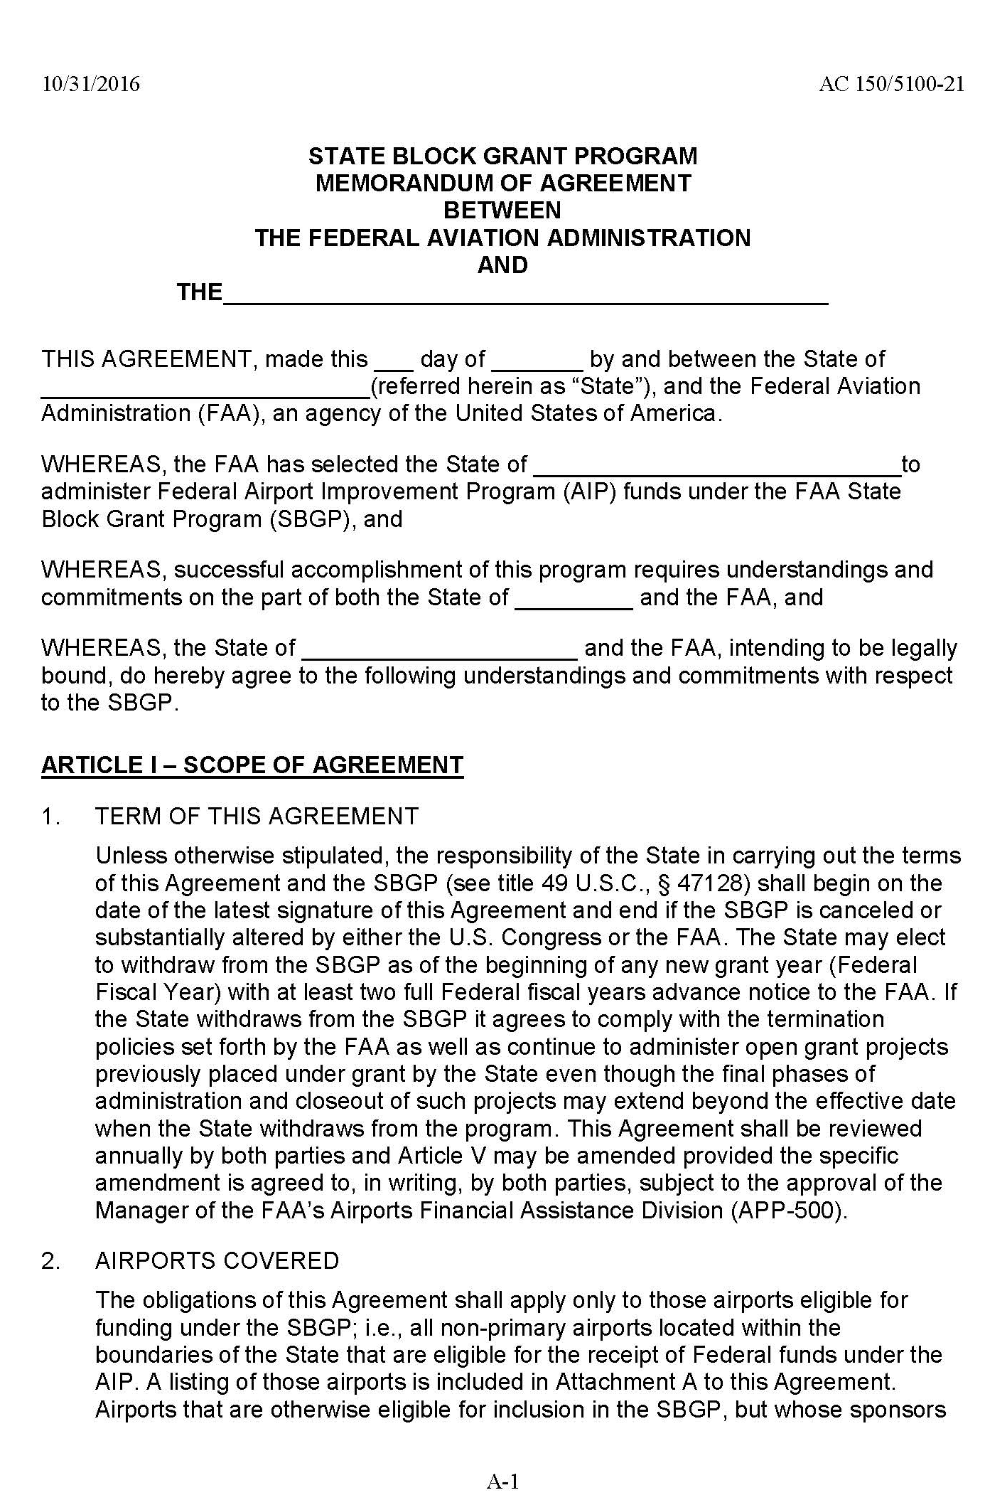
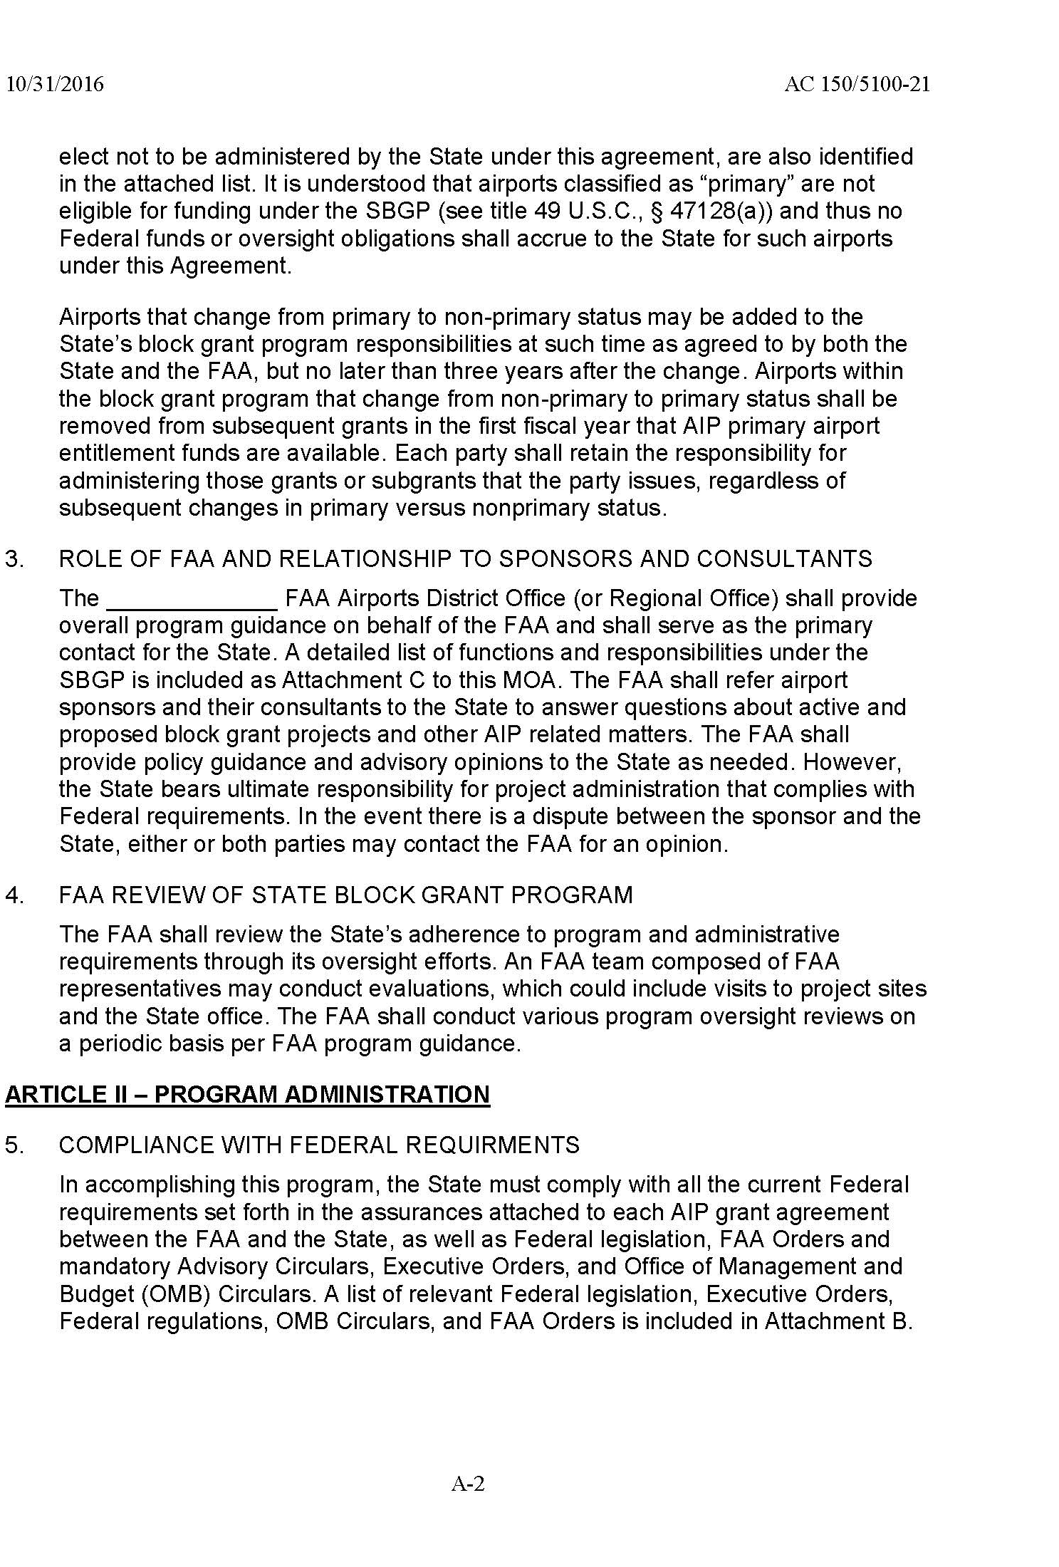

Slide 14
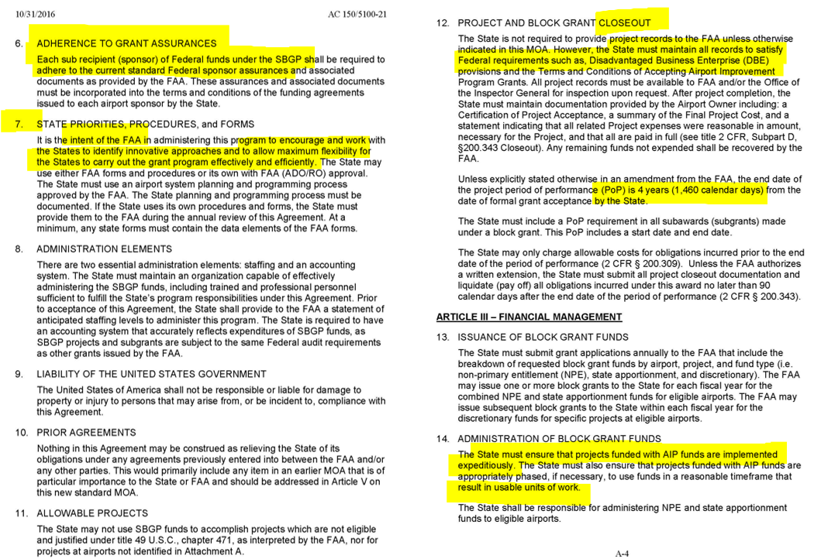

Slide 15
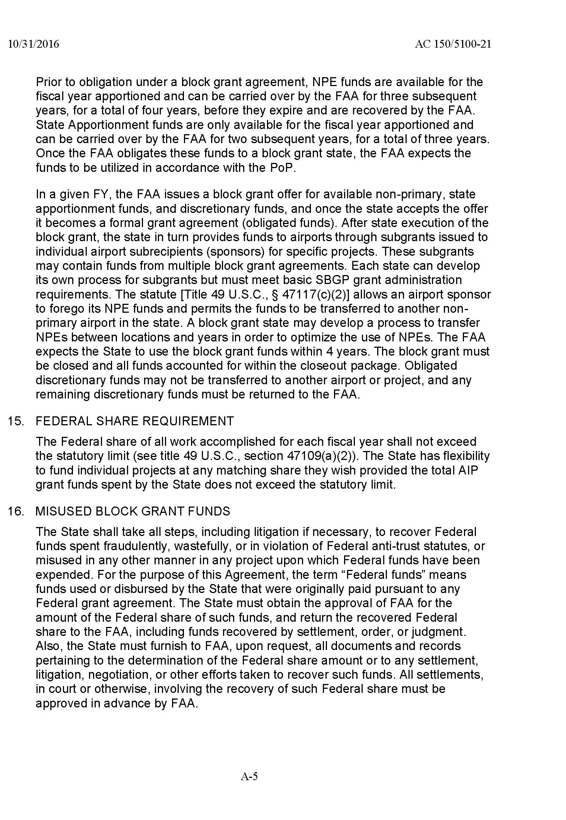
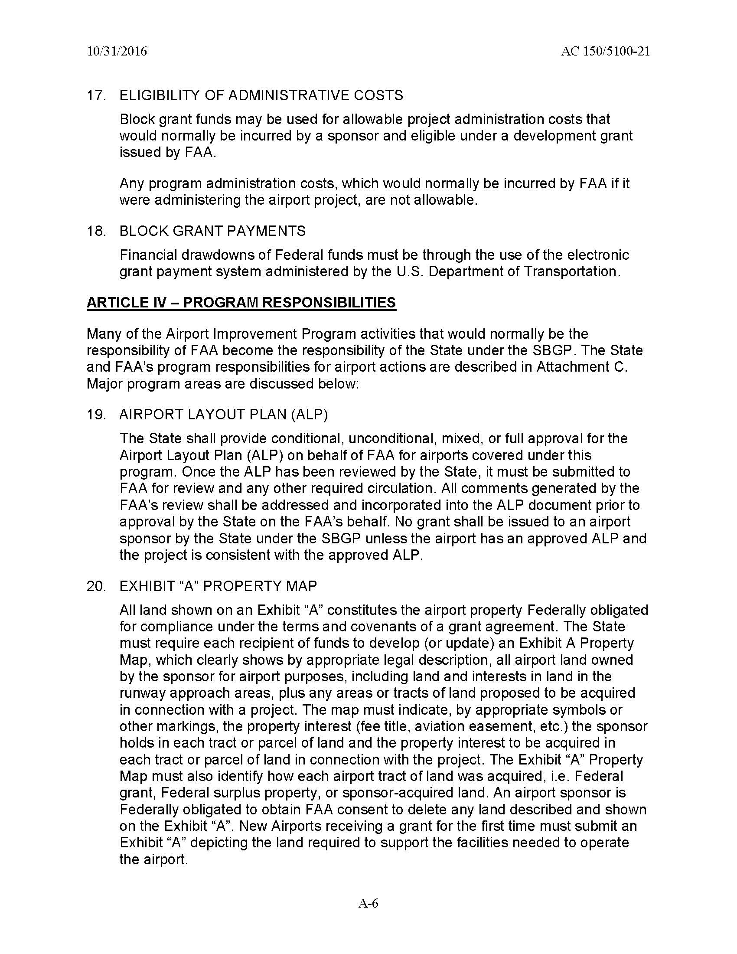
Notes:
In Presentation 101, they teach do not show exhibits like this because the audience cannot read them. So in the interests of time, I will just say the next few slides are a copy of MOA. You can read then at your leisure in SBGP AC

Slide 16
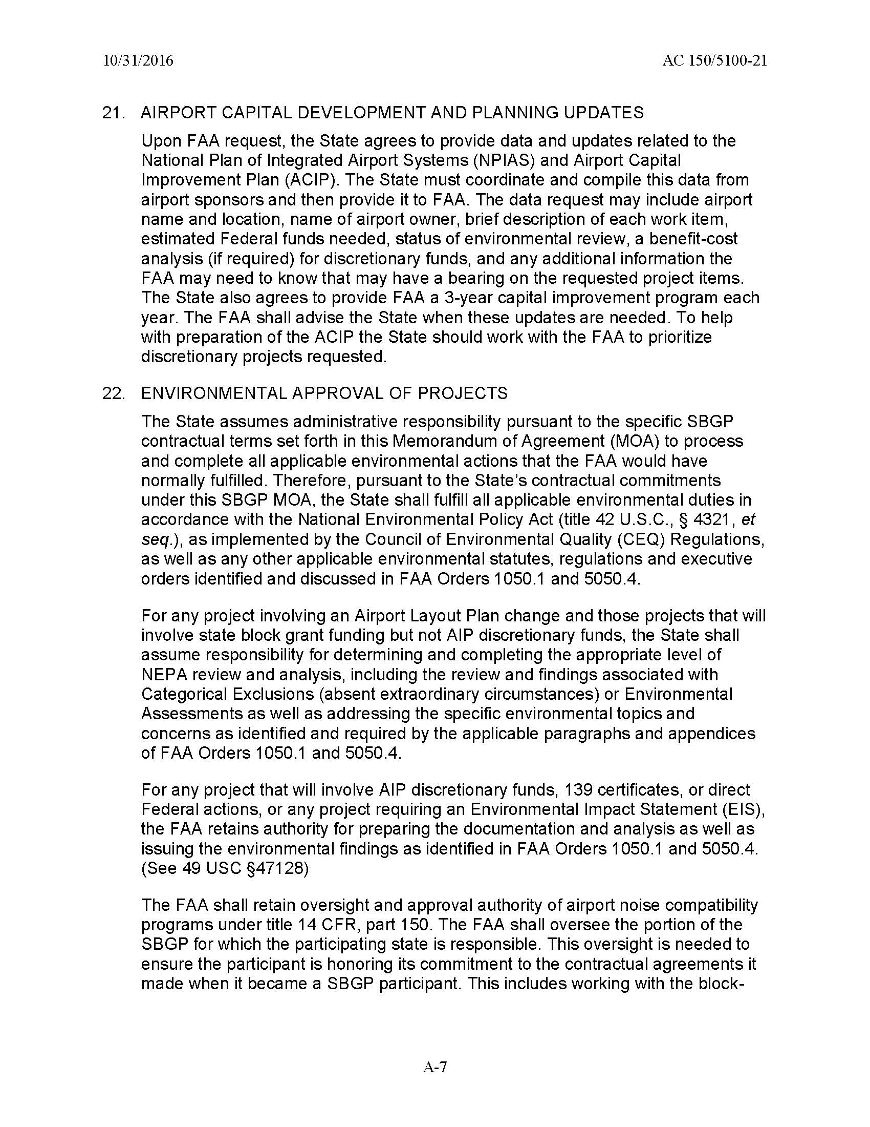
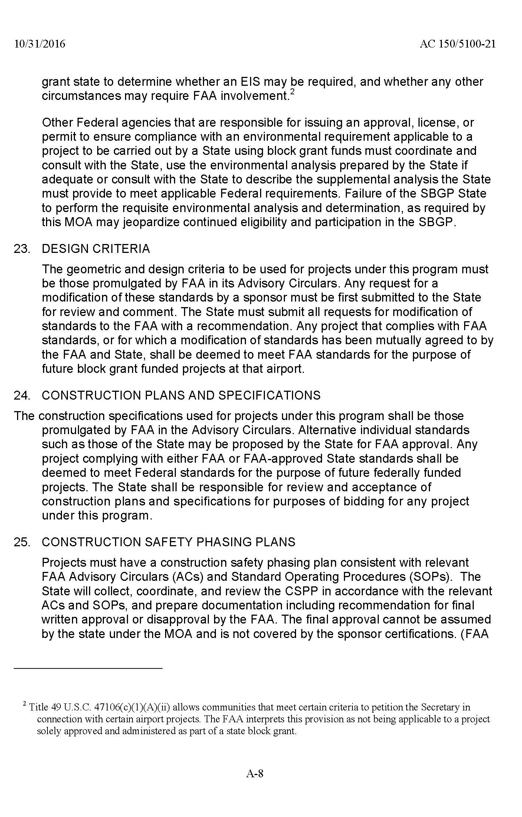

Slide 17
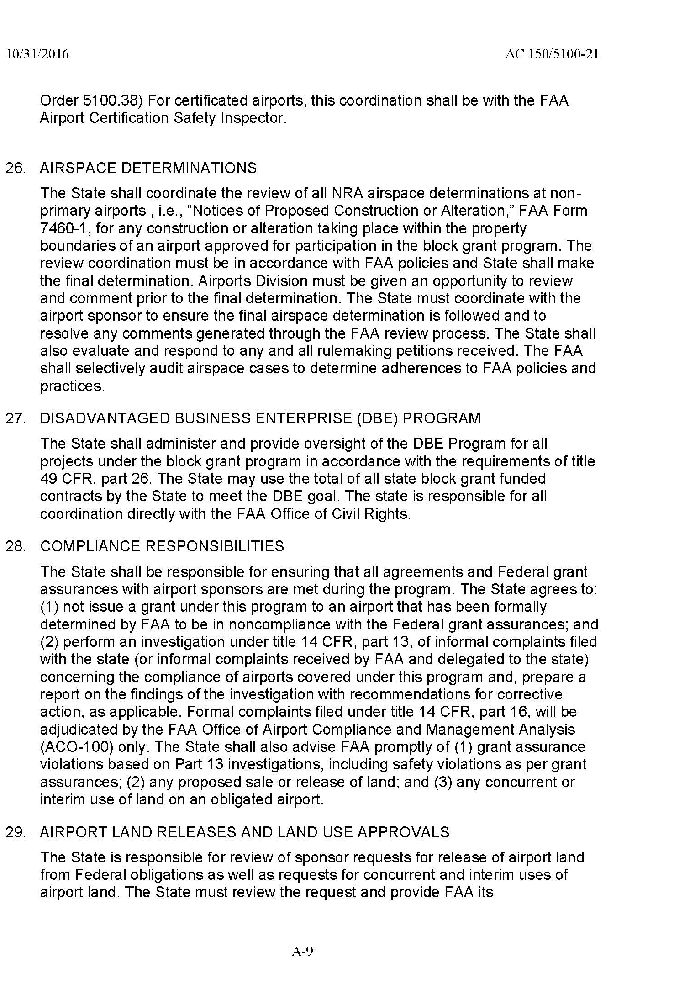
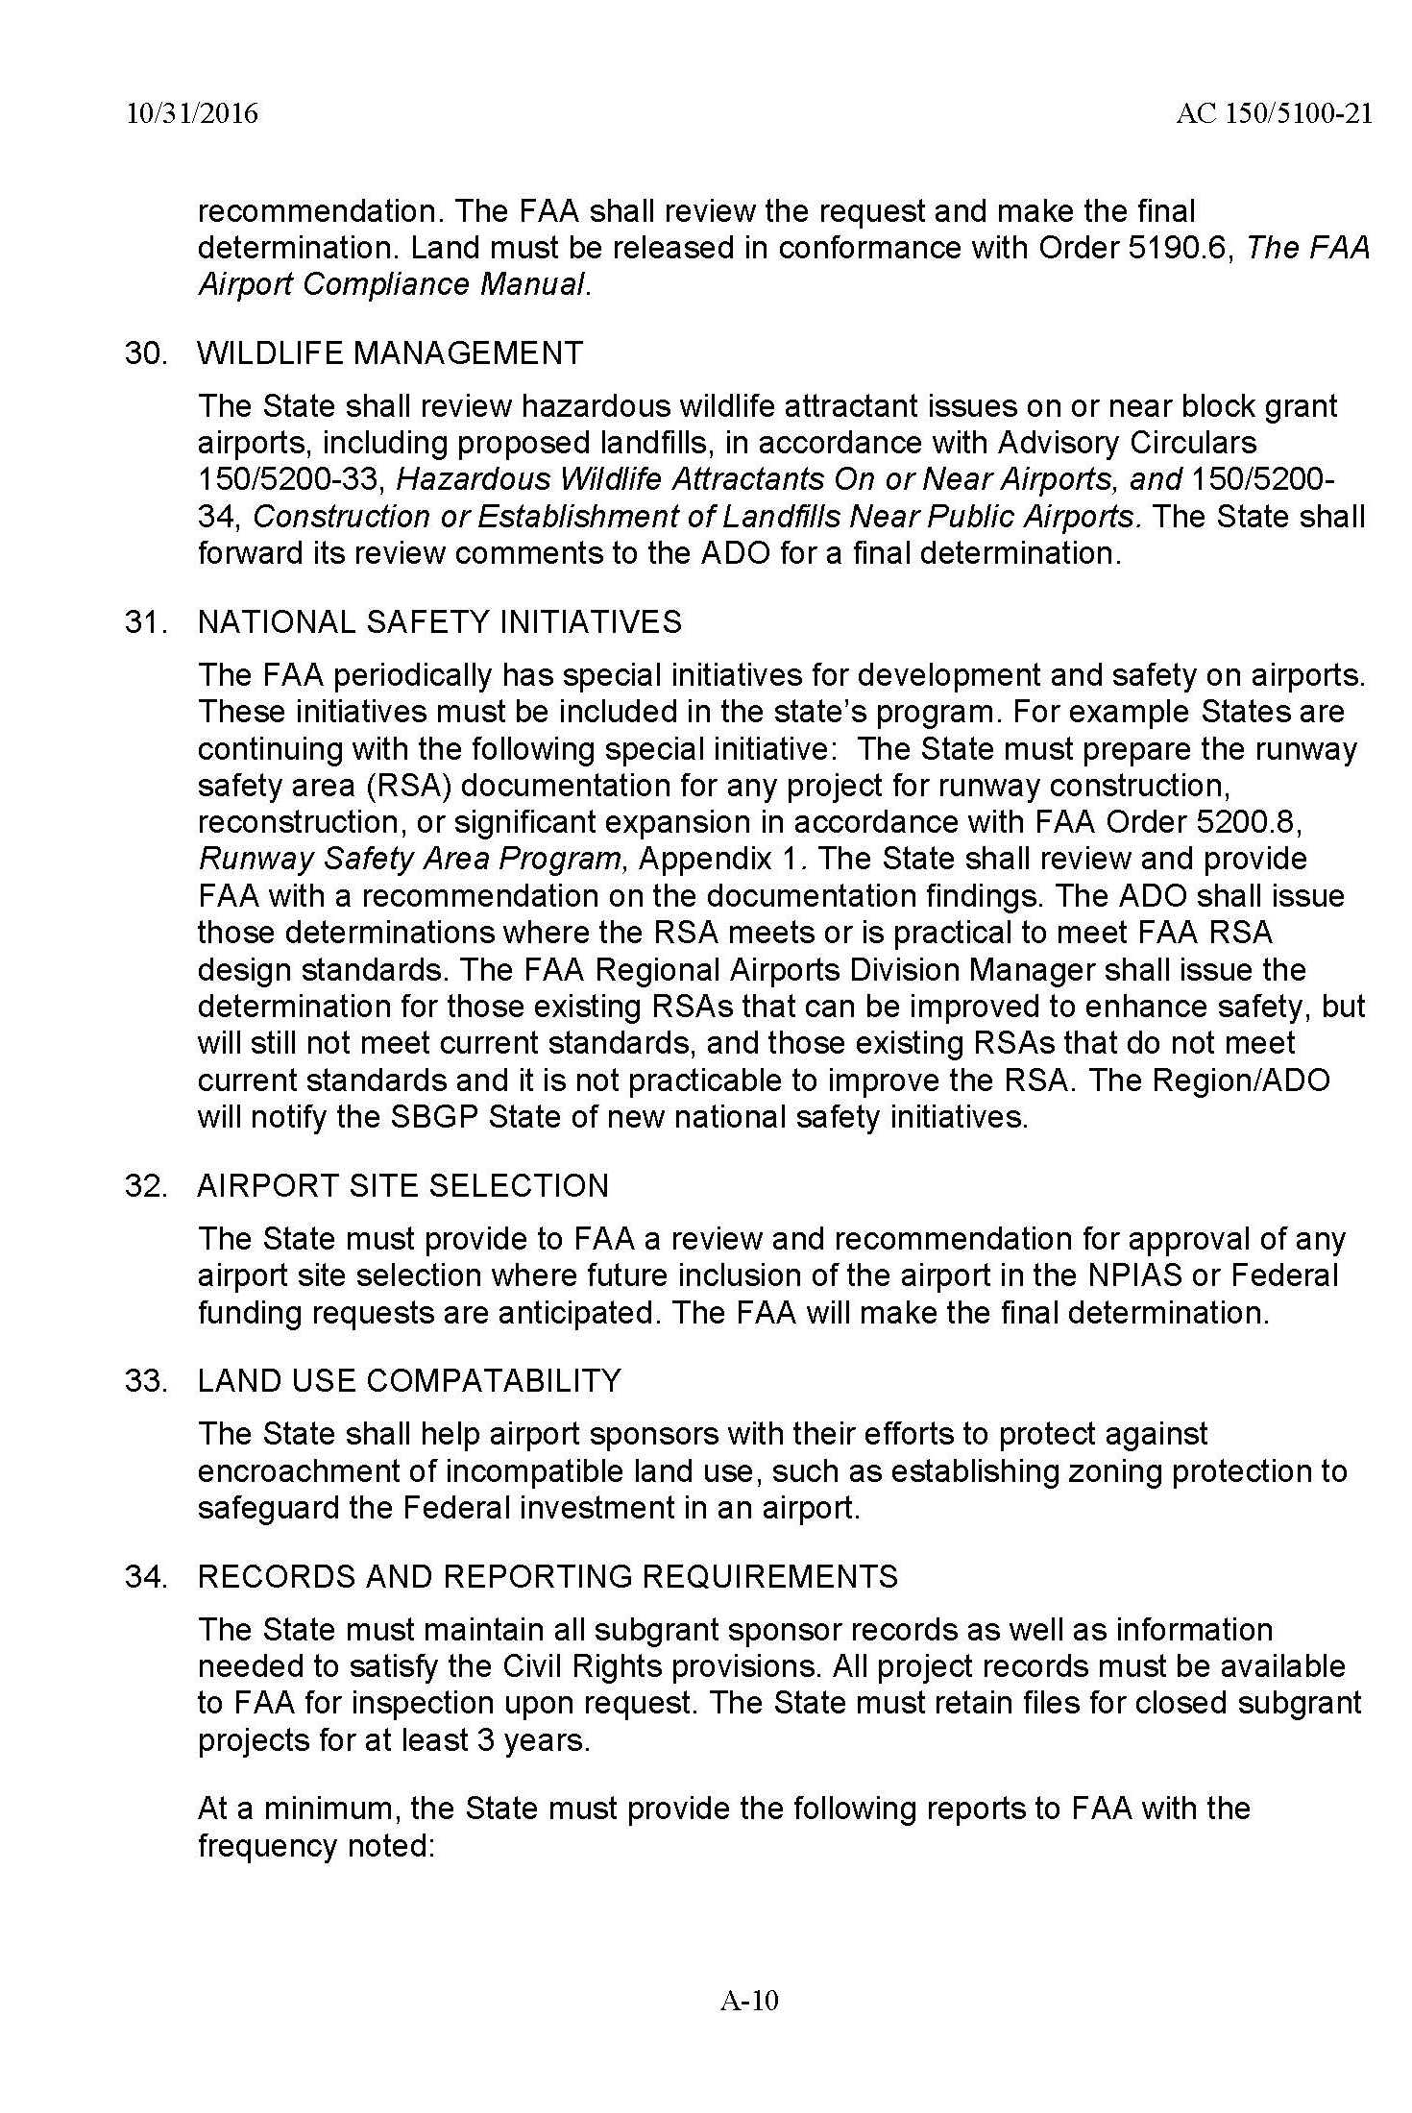

Slide 18
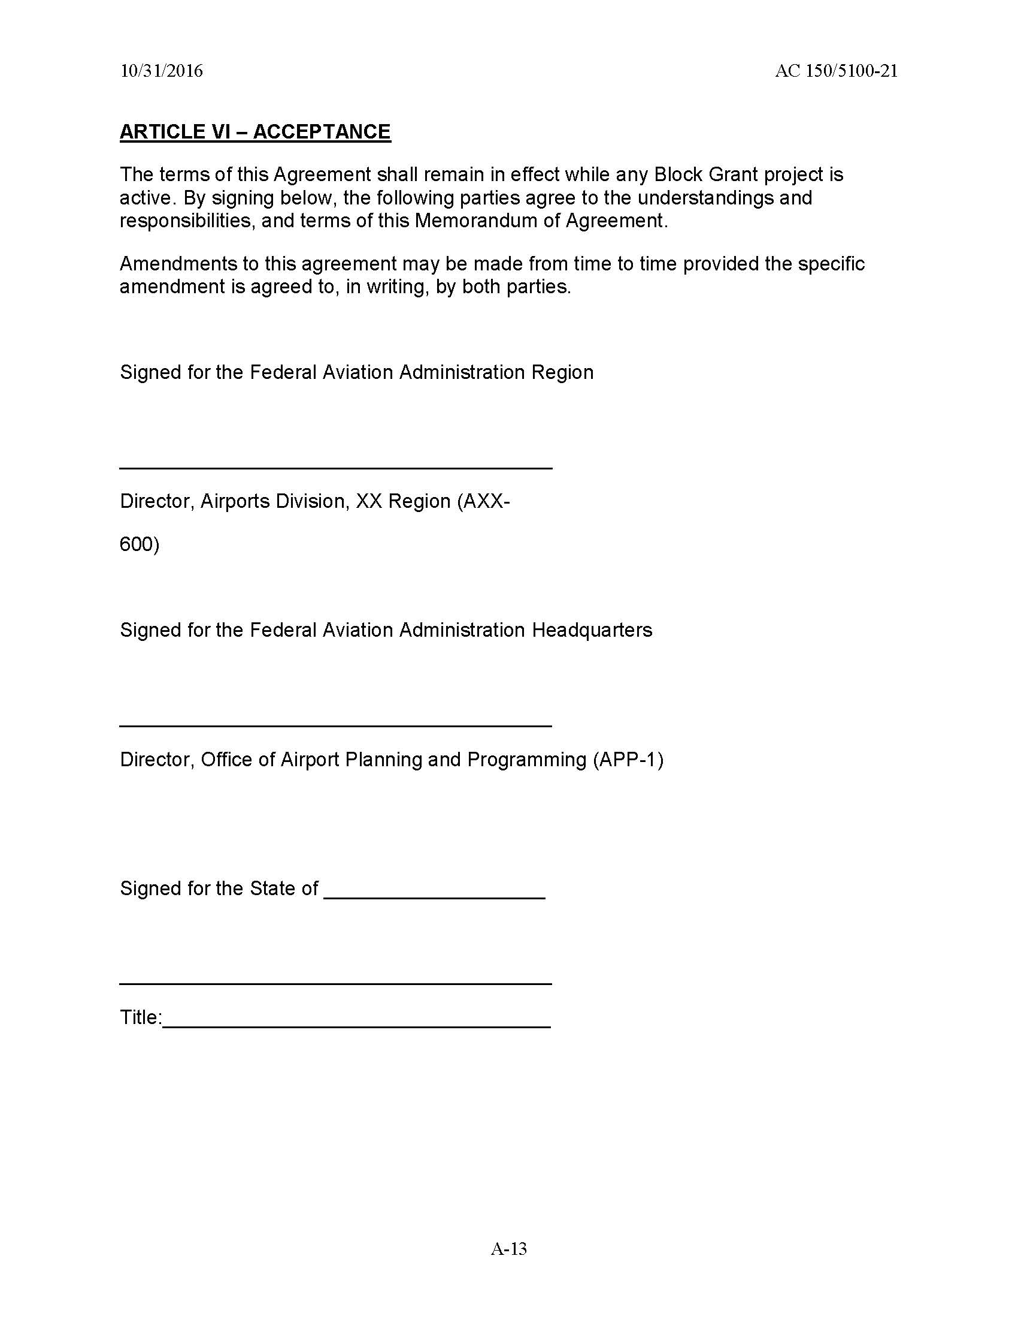
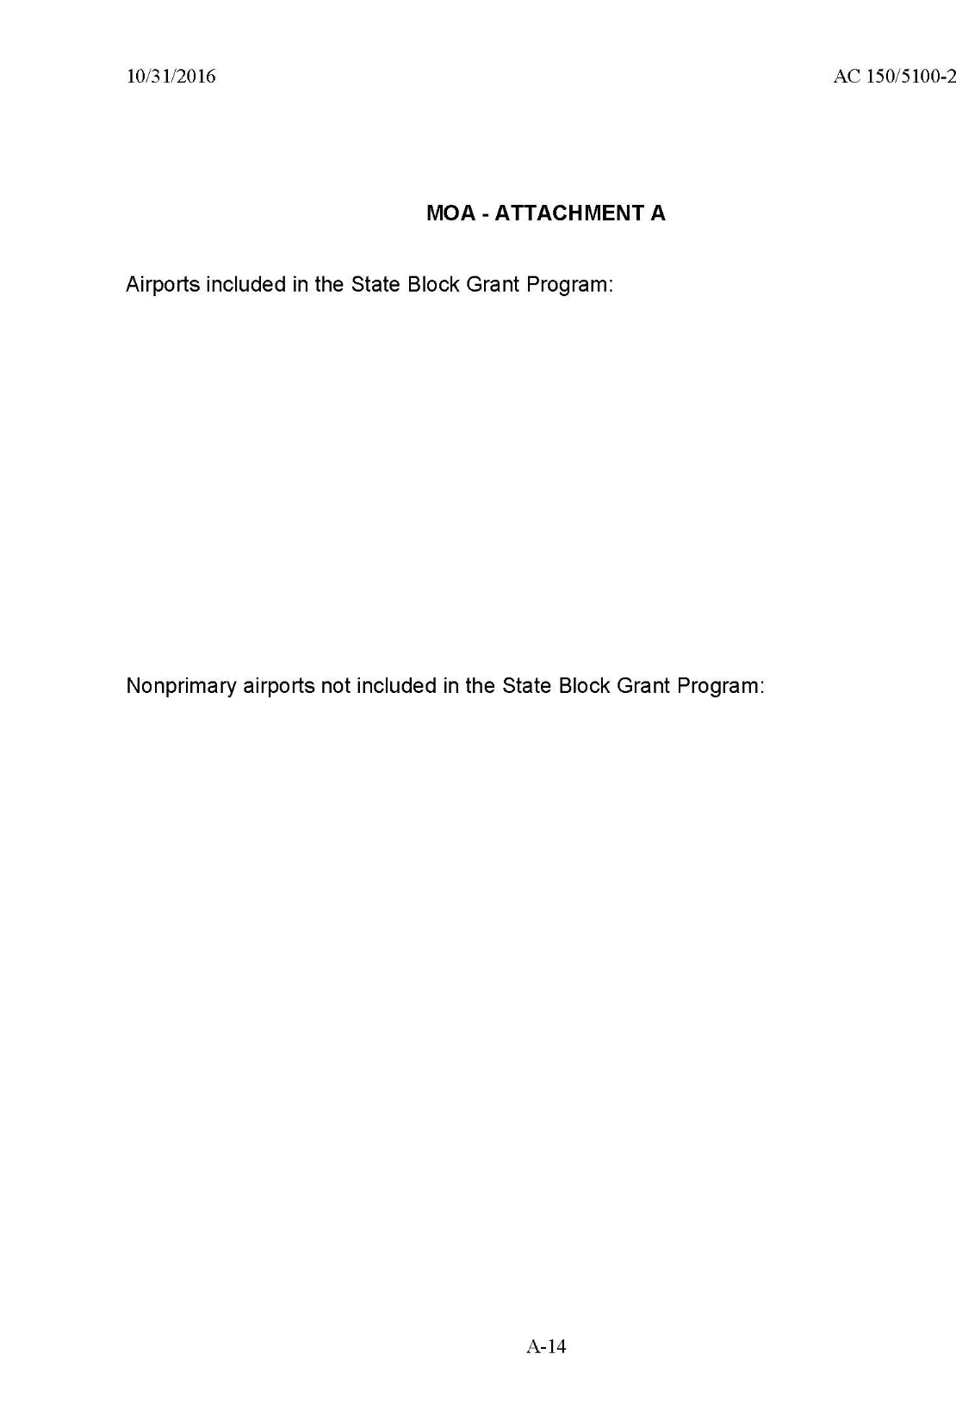

Slide 19
Challenges
State program guidance does not allow for reimbursement
Period of Performance
Timely expenditures of sub-awards
Notes:
AIP allows for reimbursement with entitlement funds for eligible work.
Period of Performance. The period of performance begins on the date the State formally accepts this agreement. Unless explicitly stated otherwise in an amendment from the FAA, the end date of the project period of performance is 4 years (1,460 calendar days) from the date of formal grant acceptance by the State.
Grants Oversight and New Efficiency ACT requires agencies such as FAA to report on grants open more than two years after the PoP

Slide 20
Questions
Notes:
Before taking questions, I would like to end with a quote which says “DO THE BEST YOU CAN UNTIL YOU KNOW BETTER. THEN WHEN YOU KNOW BETTER, YOU DO BETTER.”

