Slide 1
Effectively Communicating Your Project in a Funding Request
2018 TAA Airports Conference
Sevierville Convention Center
Adam Guy, EI
Transportation Project Specialist | 4/19/2018

Slide 2
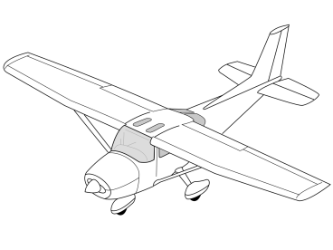
Definitions
Effective Communication – a two way information sharing process which involves one party sending a message that is easily understood by the receiving party.*
TAD Aero. receiving party
Project Managers, Program Monitors, Planning, Upper Level Management, TAC Commissioners
Project – planned set of interrelated tasks to be executed over a fixed period and within certain cost and other limitations.*
Funding Request – formally asking for a grant of authority to incur monetary obligations and to pay for them.*
*Source → http://www.businessdictionary.com
Effectively Communicating Your Project in a Funding Request

Slide 3
TAD Funding Request Requirements
Proposed project is on the…
Airport Capital Improvement Plan (ACIP)
Airport Layout Plan (ALP)
In line with the state’s priority ranking
Local Share Commitment
Detailed project funding request letter
Estimate of Engineering and/or Construction
Project Sketch (if applicable)
Project Schedule
For Federal funding requests, TAD will assist sponsor in determining if the proposed project is eligible, abiding by policies and procedures of the FAA
State Priority Ranking
Safety
Security
Pavement Preservation/Maintenance
Preservation of Infrastructure
Compliance with current FAA Standards
Planning
Increase Capacity/Modernization
Equipment
Landside Improvements
Revenue Producing

Slide 4
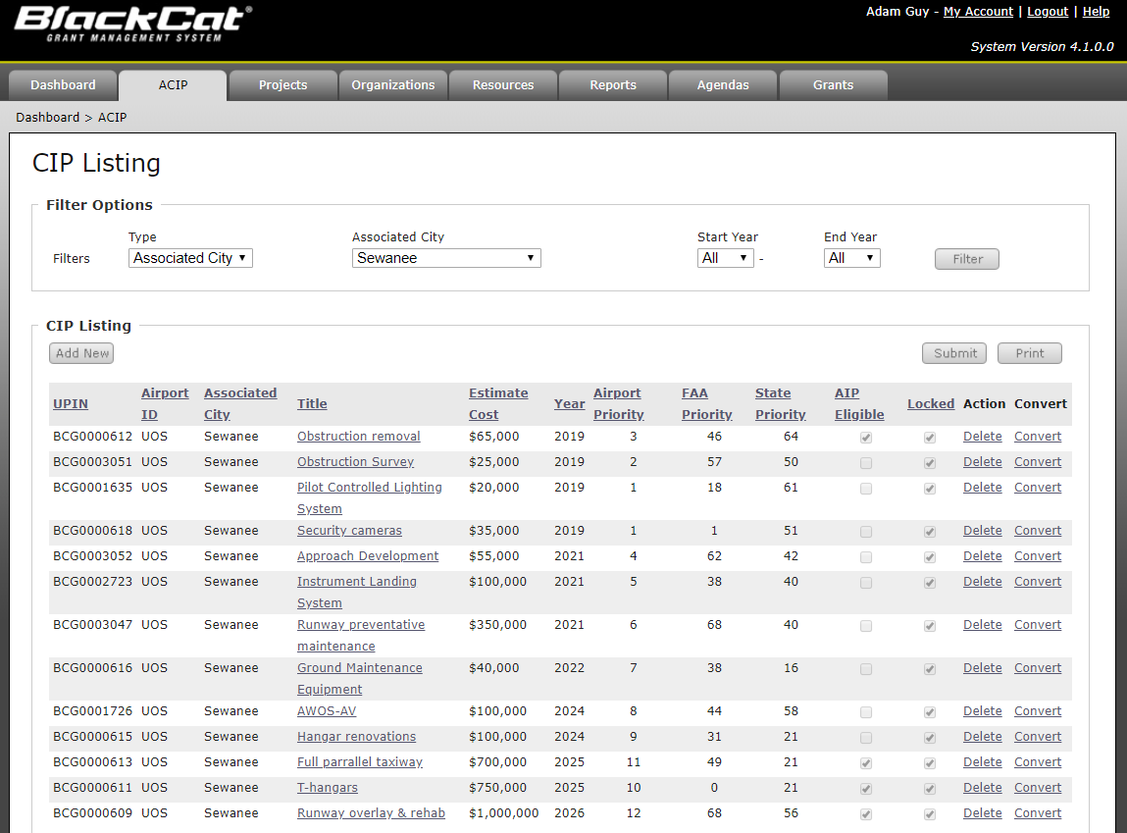
Converting Proposed Project From ACIP in BlackCat
1
2
BlackCat Grants Airport Sponsor User’s Guide

Slide 5
Editing Proposed Project Information
3
4

Slide 6
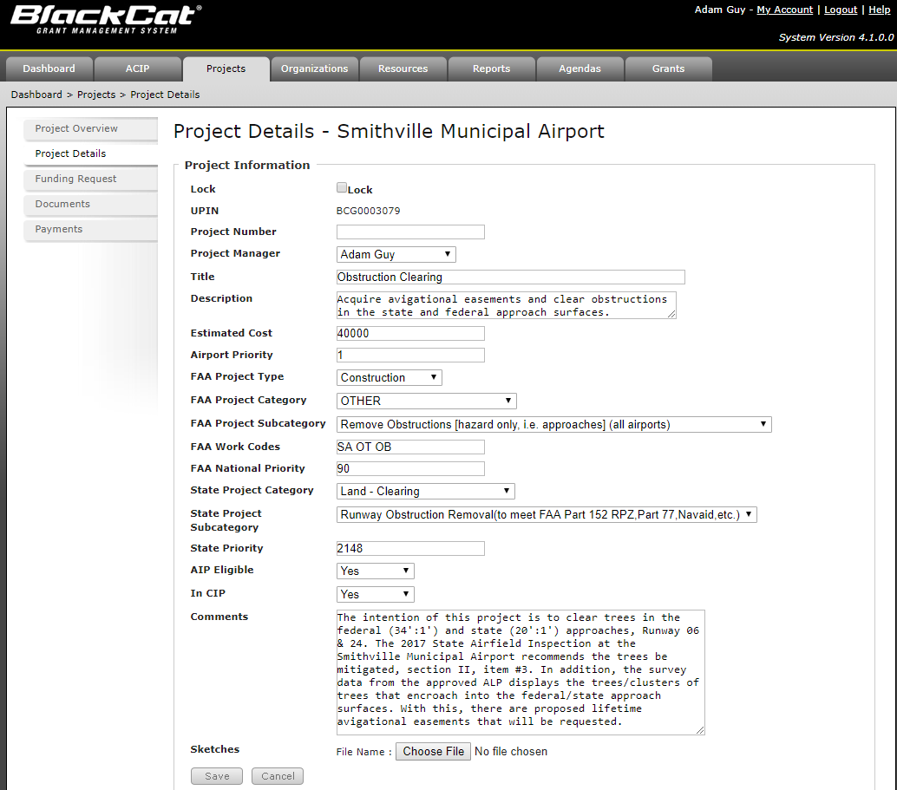
Editing Proposed Project Information
Detailed Project Description/Justification
Please reference (if applicable):
PCI Report
PCI value & Pavement Section ID #
Inspection Report
State and/or FAA Inspection
ALP or Master Plan
IFRs
Environmental Findings
RSA Determination
Obstruction Survey
Runway Justification Study
Wildlife Management Study
Noise Study
Other relevant technical guidance
ACIP
FAA Order 5100.39A, Appendices 5 & 6
AIP Handbook FAA Order 5100.38D

Slide 7
Project Funding Request

Slide 8
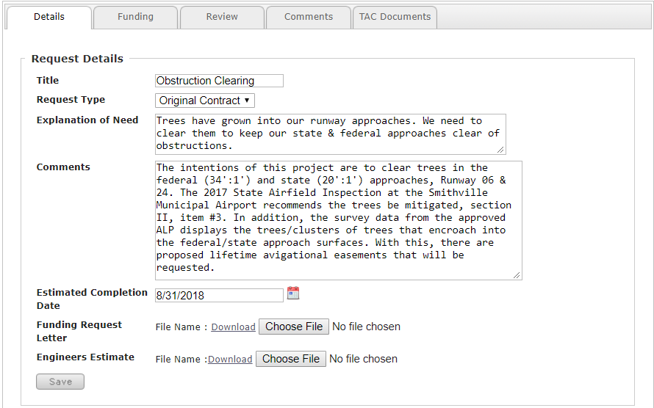
Project Funding Request
Original or Amendment
When do we expect the grant to be closed? (Typically 3 months after work is complete is complete)
With schedule and project sketch (if applicable)

Slide 9
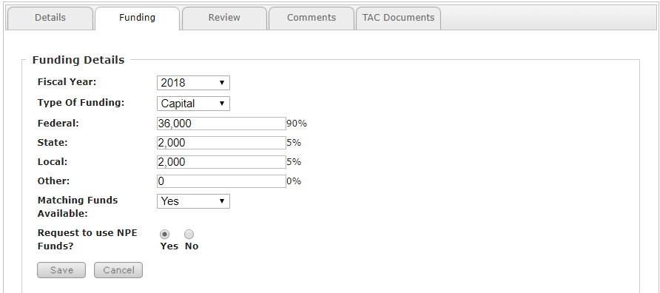
Project Funding Request
Capital or Planning
Input dollar amounts into the text boxes, the percentages will auto populate

Slide 10
Project Funding Request
Please do not forget to click “Submit”
After submittal, TDOT project manager gets an email alert

Slide 11
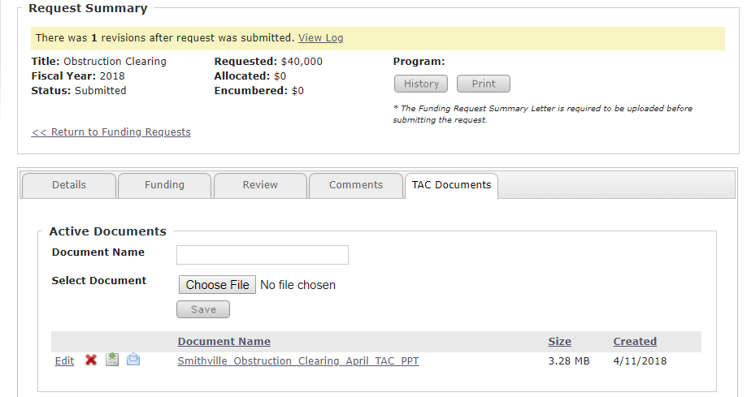
Project Funding Request
Project supporting documentation

Slide 12
Project Request Letter Requirements
Authority, County, or City Letterhead
Date letter is signed
Subject: Request for funding for [Project]
Body: Information about the proposed project
Affected areas?
Goal of the project?
Reference technical documents for support
Total Cost of the project (requesting state and/or federal funds?)
Written commitment to the local match
Authorization from grantee signatory

Slide 13
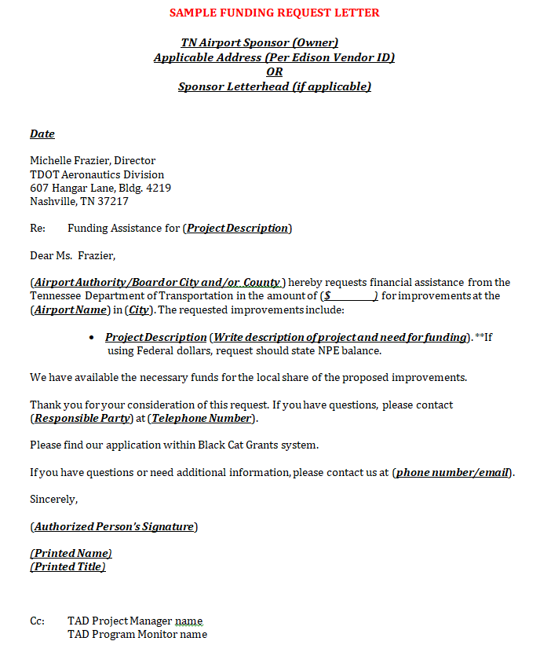
Why are you requesting the money?
Local Share commitment
Grantee Signatory

Slide 14
Engineering Estimate
Must include:
Airport
Project name
Preliminary Level Estimate
[0%, 30%, 60%, 90%, bid, etc.]
Date
Breakout of task and/or item descriptions
Task hours
Quantities
Unit costs
Total costs
Please review project costs
Reach out to TDOT project manager for assistance once sponsor review is complete

Slide 15
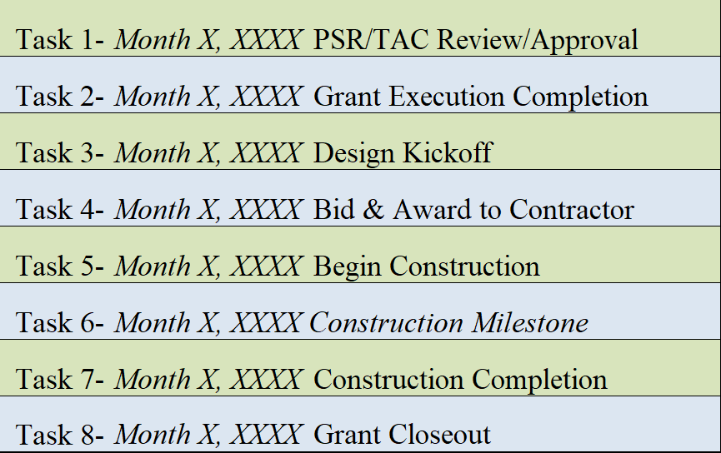
Project Schedule
Schedules vary slightly
Pinpointing exact days is key
Major Milestones
Realistic Schedule
Typically a month after approval
Typically 3 months after construction completion

Slide 16
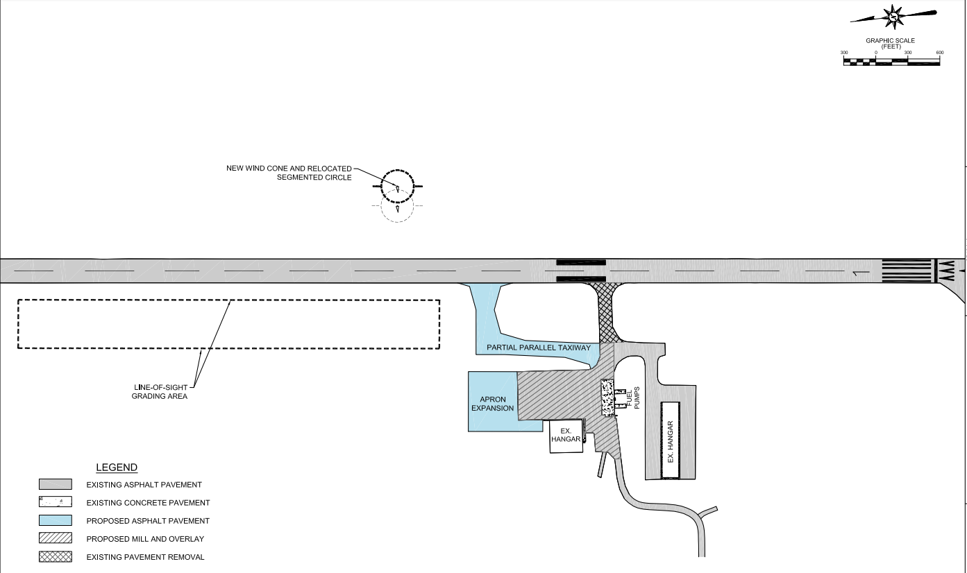
Project Sketch
North Arrow & Scale
Concise Legend

Slide 17
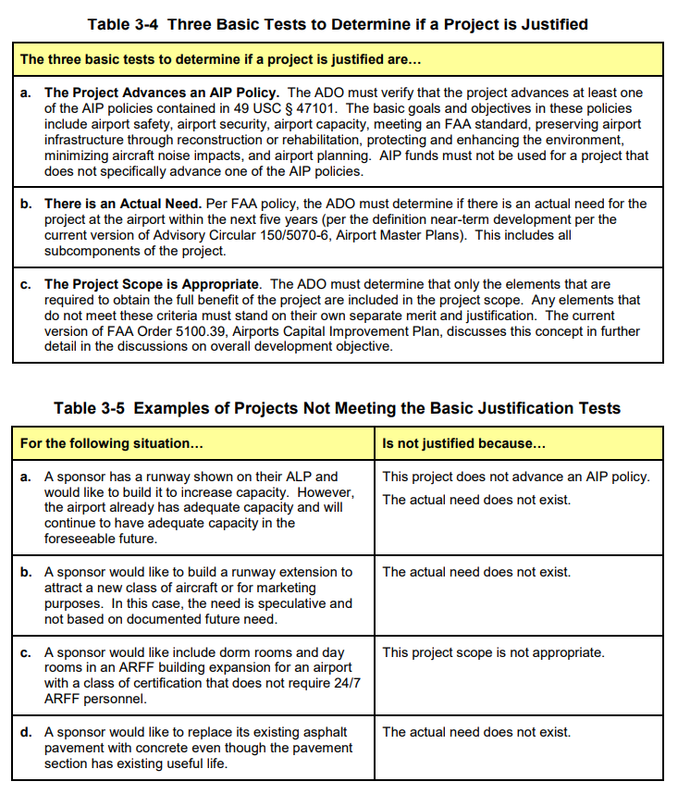
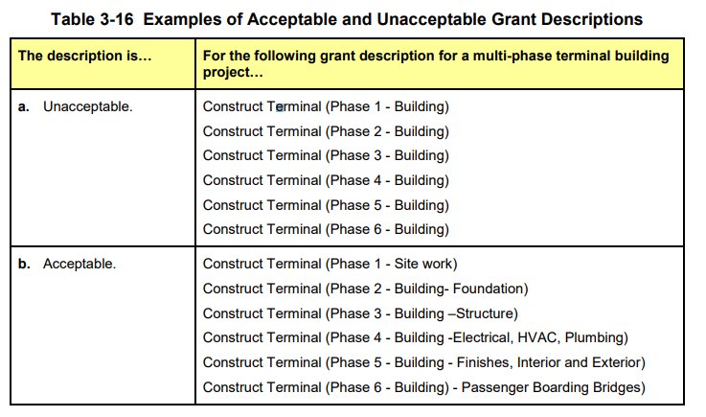
What do we look for when reviewing a Project?
Is the project state or federally eligible?
Does the project abide by State/FAA priority relative to sponsors airfield?
Is the project justified?
3 basic tests
Is the project on airport property?
Is the project on the current FAA approved ALP?
Is the project on the ACIP?
Are there any environmental concerns?
If the project is phased, will it result in a usable unit of work?
Will the project be planned, designed, and/or constructed to Local, State, and Federal standards?
AIP Handbook
FAA Order 5100.38D

Slide 18
What do we look for when reviewing a Project?
How much risk is involved with this project?
What kind of procurement measures will be necessary?
Are the costs allowable and reasonable?
Can the project be completed without unreasonable delay?
Reference: FAA AIP Project Evaluation Review and Development Analysis Checklist (PERADA)
https://www.faa.gov/documentLibrary/media/Form/faa-form-5100-109-PERADA-201610.pdf

Slide 19
Emergency Grant Requests
Notify appropriate TAD staff ASAP
(Written Format Preferred)
Here are elements that TAD considers/requires for Emergency Requests, but not limited to:
Is it an emergent situation that requires immediate action?
Is this in the best interest of the safety of the flying public, in regards to immediate action?
Can the concern be temporarily fixed or mitigated?
Are there parts of the airfield that are temporarily inoperable? Should there be?
When is emergency work intended to begin?
Is it eligible for state reimbursement?
Submit a formal and detailed emergency funding request into BlackCat
Include:
Project Request Letter
Engineering Estimate and Schedule (if applicable)
Please acknowledge when the sponsor incurs costs without grant; there is no guarantee the project will be eligible for reimbursement. However, required emergency projects are often reimbursable.

Slide 20
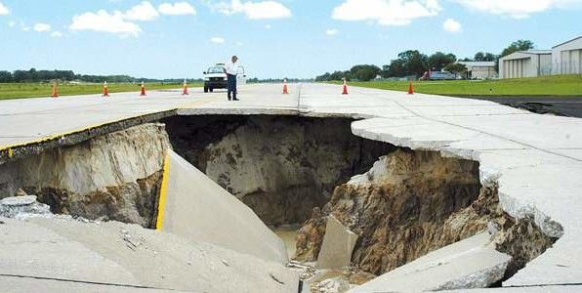
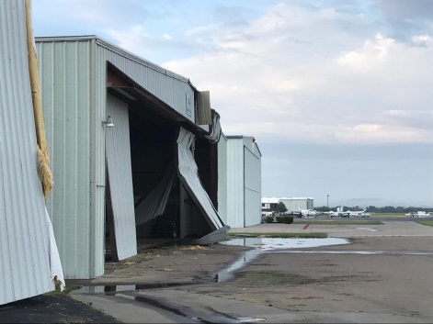
Example Emergency Airfield Projects
Examples (not limited to)
Sinkhole Repair
Pavement Repair (primary operating areas)
Storm Damage Repair for Airport Facilities
Lighting /Airfield Sign Repair
Security Repair
Utility/Storm Pipe Repair
Preventable… (incorporate into ACIP):
Obstructions
Rubber Removal
Land
Drainage
Pavement

Slide 21
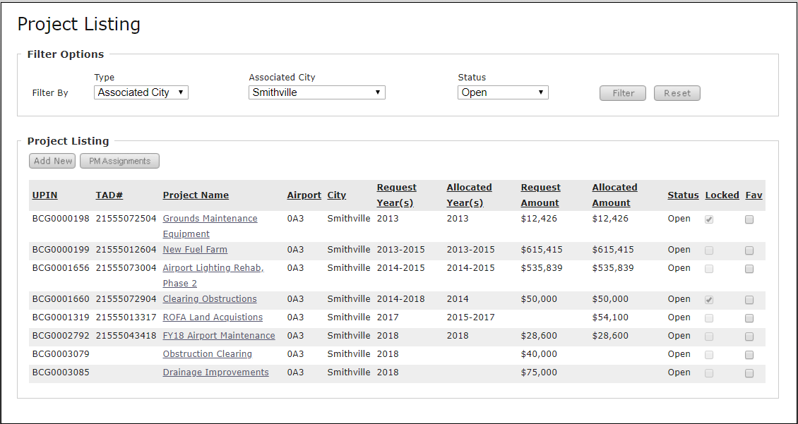
Funding Request for Emergency and Amendment Requests in BlackCat
Projects Tab
“Add New”
Once project is added, you can add a funding request.

Slide 22
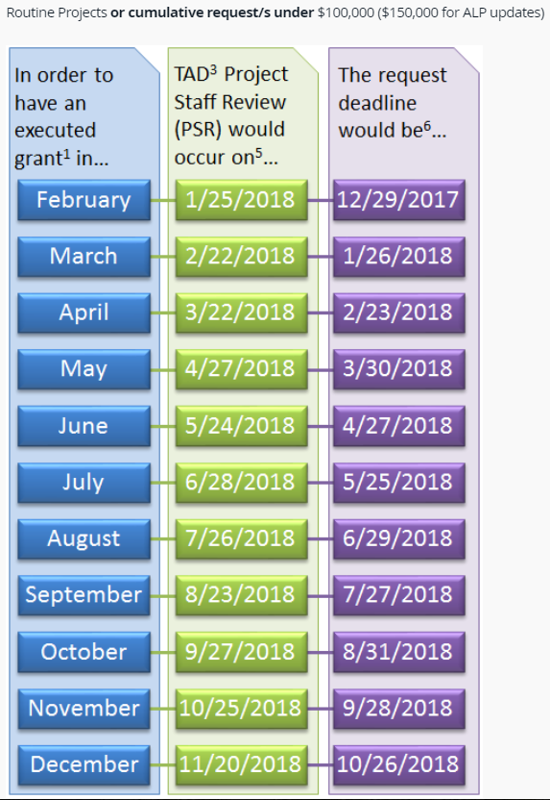
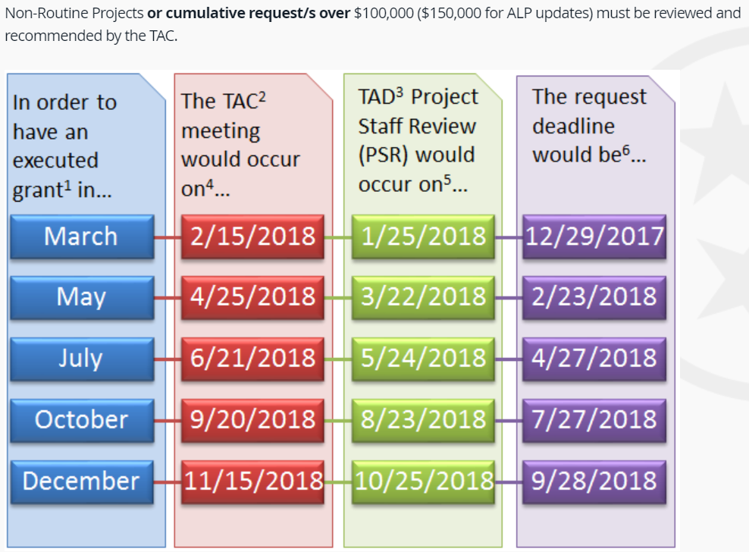
Resources
https://www.tn.gov/tdot/aeronautics/planning.html
Calendar Year 2018: Key Dates and Request Deadlines
TAC Projects
PSR Projects

Slide 23
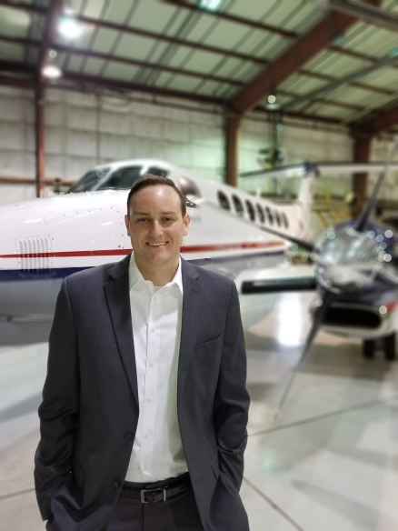
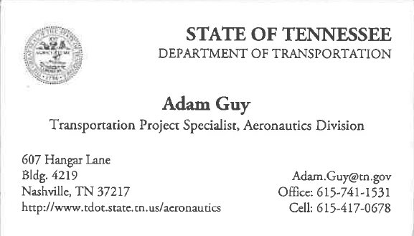
Resources
Visit our Website!
Sample TAC Presentation
TDOT Aero Sample Project Request Letter
Proposed hangar request form
Detailed project schedule
TAC Policies
BlackCat Grant Management System Login Request Form
Airport Management Guide
Funding Request Deadlines
https://www.tn.gov/tdot/aeronautics.html

